Slide 1
Types of Versioning
Media type Versioning(using produces )
GITHUB uses this kind of versioning . We pass Accept Value in Request
Custom Header Versioning (using headers )
Microsoft uses this kind . We pass Custom Header Value in Request
URI Versioning
Twitter uses this kind. We use different uri for different version.
Parameterized Versioning(using params)
We pass different parameters in URI Itself. Amazon uses this.

Slide 2
Different Ways to version Rest Api in Java
URL Versioning:
In this kind of versioning, we specify different url for different versions.
//Example of URL Versioning//
@GetMapping("v1/person")
public String personv1()
{
return new PersonV1().toString();
}
http://localhost:8080/v1/person
@GetMapping("v2/person")
public String personv2()
{
return new PersonV2().toString();
}
http://localhost:8080/v2/person

Slide 3
Parameterized Versioning
// Example of Parameterised versioning http://localhost:8080/person/param?version=1
@GetMapping(value="person/param",params ="version=1")
public String paramV1() {
return new PersonV1().toString();
}
http://localhost:8080/person/param?version=2
@GetMapping(value="person/param",params="version=2")
public String paramV2() {
return new PersonV2().toString();
}

Slide 4
Header Versioning
// Example of Header versioning
@GetMapping(value="person/header",headers="x-api-version=1")
public String headerV1() {
return new PersonV1().toString();
}
@GetMapping(value="person/header",headers="x-api-version=2")
public String headerV2() {
return new PersonV2().toString();
}

Slide 5
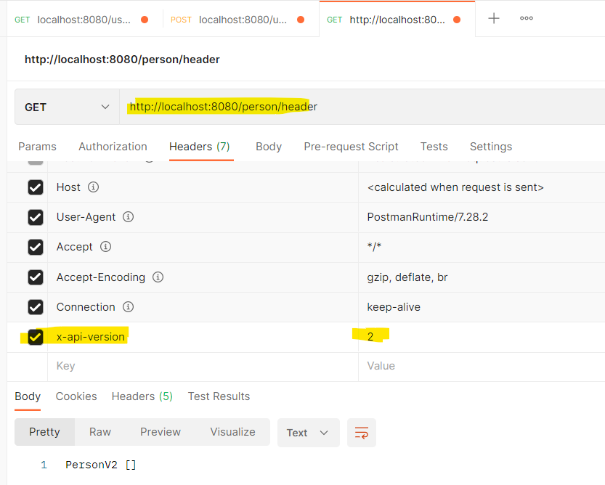
Header Versioning

Slide 6
Producer Versioning
// Example of Producer versioning
@GetMapping(value="person/produces",produces="ap/version1+json")
public String producesV1() {
return new PersonV1().toString();
}
http://localhost:8080/person/produces
@GetMapping(value="person/produces",produces="ap/version2+json")
public String producesV2() {
return new PersonV2().toString();
}

Slide 7
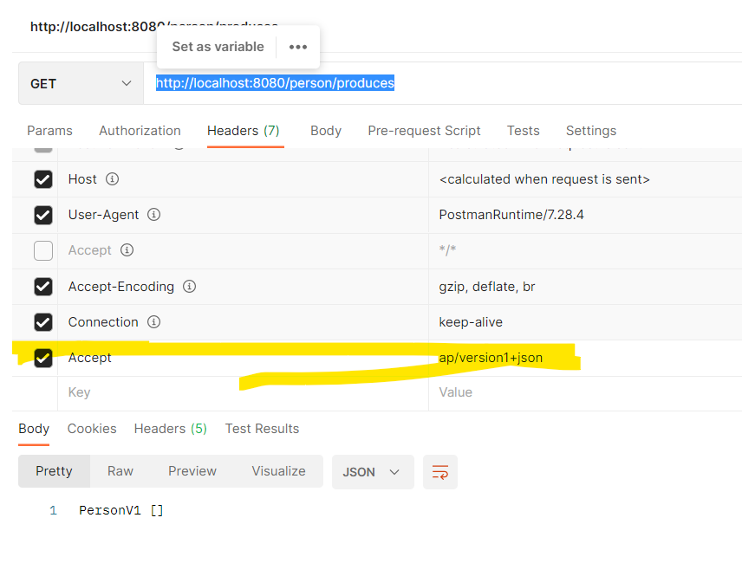

Slide 8
Which is better or worse?—No one is perfect
URI Pollution:-
Parametrized causes this pollution
Misuse of http headers
Header and Content versioning causes misuse , as headers were not intended to use versioning
Caching
Header and Content versioning can’t be used for caching since they use same url but different headers
Can be used in browser?
Header and Content versioning can’t be used in browser.
API documentation
Its easy for Parameterised and uri versioning.

